Slide 1
Machine Learning Lab 1 – Decision Trees

Slide 2
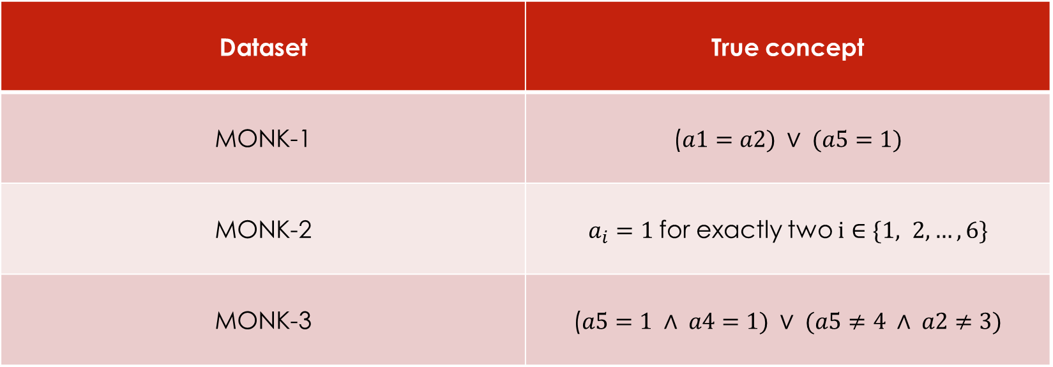
Assignment 0
Assignment 0
Dataset | True concept
MONK-1 | ($a1=a2) ∨ (a5=1)$
MONK-2 | $a_{i}=1$for exactly two $i∈\{1, 2, …, 6\}$
MONK-3 | ($a5=1 ∧ a4=1) ∨ (a5≠4 ∧ a2≠3)$
MONK-2 is the most difficult dataset to learn because it requires a global logic instead of a local one, but decision trees are usually trained based on single attributes and their information gain or GINI index.

Slide 3
Assignment 1
Dataset | Entropy
MONK-1 | 1.0
MONK-2 | 0.9571
MONK-3 | 0.9998

Slide 4
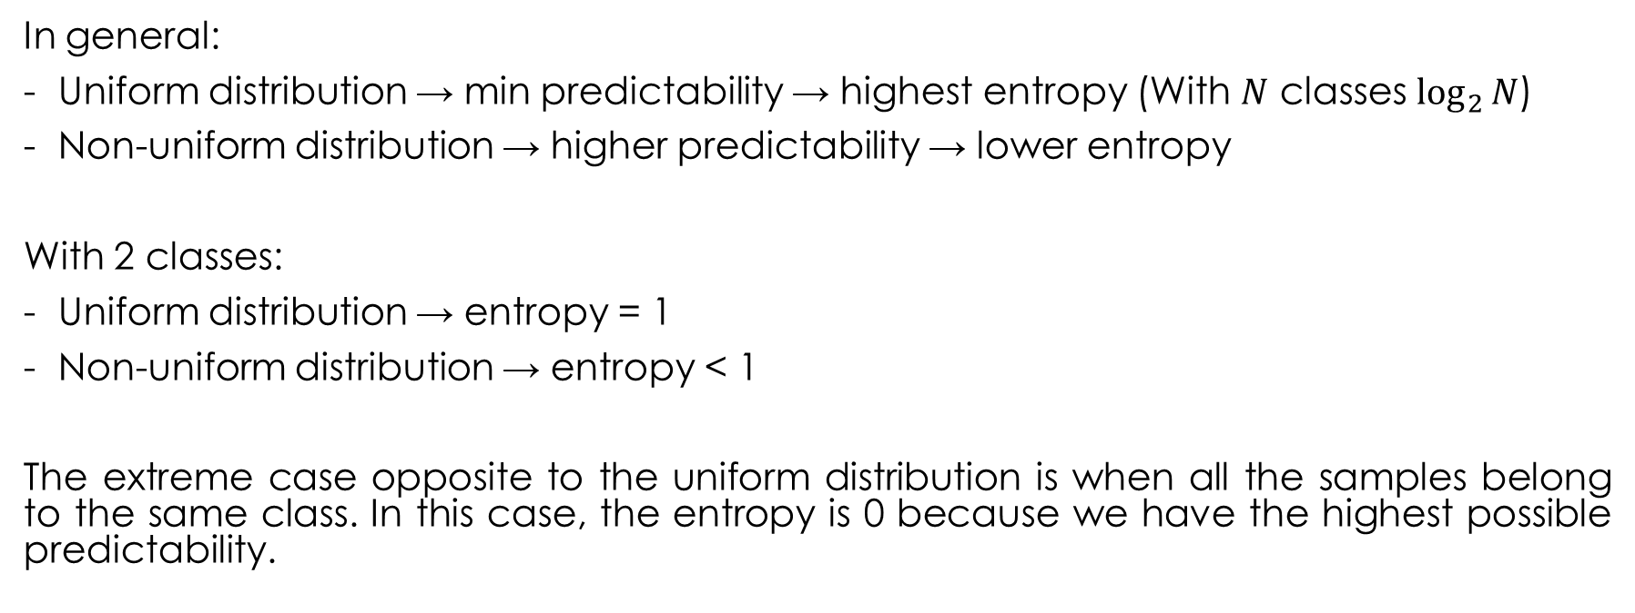
Assignment 2
In general:
Uniform distribution → min predictability → highest entropy (With $N$ classes $\log_{2}{N}$)
Non-uniform distribution → higher predictability → lower entropy
With 2 classes:
Uniform distribution → entropy = 1
Non-uniform distribution → entropy < 1
The extreme case opposite to the uniform distribution is when all the samples belong to the same class. In this case, the entropy is 0 because we have the highest possible predictability.

Slide 5
Assignment 3
Dataset | a1 | a2 | a3 | a4 | a5 | a6
MONK-1 | 0.0753 | 0.0058 | 0.0047 | 0.0263 | 0.287 | 0.0008
MONK-2 | 0.0038 | 0.0025 | 0.0011 | 0.0157 | 0.0173 | 0.0062
MONK-3 | 0.0071 | 0.2937 | 0.0008 | 0.0029 | 0.2559 | 0.0071

Slide 6
Assignment 4
Using the split that maximizes the information gain, the entropies of the subsets are such that their weighted sum is minimized.
This implies that the predictability after splitting is improved and the improvement is the best among the possible splits.

Slide 7
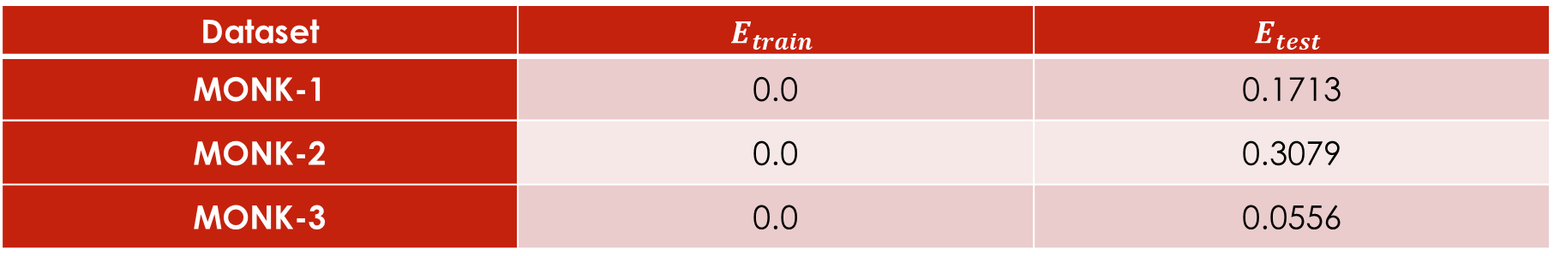
Assignment 5
Dataset | $$E_{train}$$ | $$E_{test}$$
MONK-1 | 0.0 | 0.1713
MONK-2 | 0.0 | 0.3079
MONK-3 | 0.0 | 0.0556
These results confirm that:
- MONK-2 is the most difficult dataset to learn with decision tree.
- MONK-1 is a bit hard to train because it involves a relationship between two attributes (a1 = a2) and we have trained the tree using one attribute at a time.
- MONK-3 has 5% of misclassification in the training set, so the performance is not perfect (but very good).

Slide 8
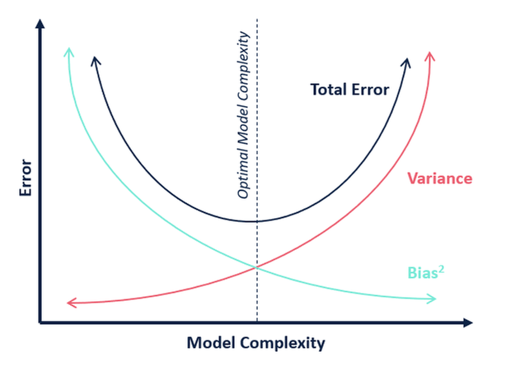
Assignment 6
When the tree is fully grown, we have the highest complexity for the model that leads to smallest possible bias but high variance.
Pruning allows us to reduce complexity of the model, avoiding overfitting, and a better bias-variance trade off that leads to the minimum total error.

Slide 9

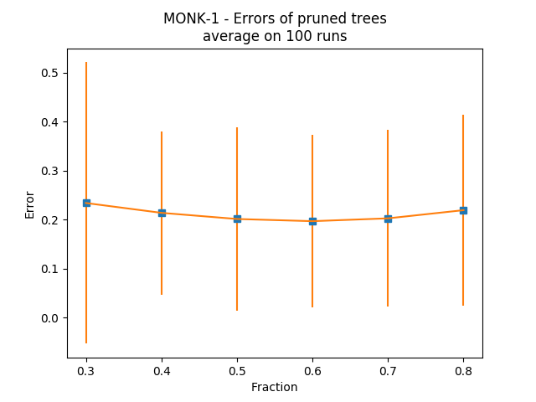
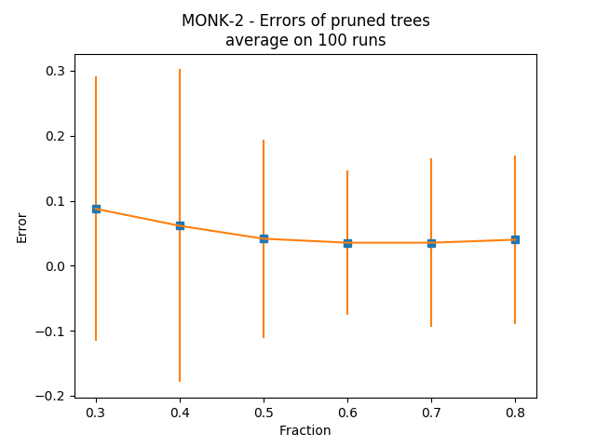
Assignment 7
V needs to be large enough to provide statistically meaningful instances.
At the same time we need to have enough data to train the model effectively.

